Slide 1

INFORMATION HIDING
Watermark Embedding in Transform Domain
Adib Nikjou, Shiraz University of Technology, Summer 2025

Slide 2
Lecture Overview Watermark Embedding in Transform Domain
1. Introduction to Transform Domain Watermarking
Motivation for Transform Domain Approaches
Fundamental Principles
Common Transform Types
Transform Properties Relevant to Watermarking
2. Watermarking Techniques in Transform Domain
LSB-Based Methods in Transform Domain
Substitution-Based Watermarking

Slide 3
Lecture Overview Watermark Embedding in Transform Domain
3. DCT-Based Watermarking: A Comprehensive Case Study
System Overview
Detailed Embedding Procedure
Extraction Procedure
4. Advanced Optimization: Genetic Band Selection (GBS)
Motivation for Optimization
Genetic Algorithm Fundamentals
Fitness Function Design

Slide 4
Introduction to transform domain watermarking

Slide 5
Introduction to Transform Domain Watermarking Motivation for Transform Domain Approaches
Digital watermarking in the spatial domain, while simple to implement, suffers from several limitations:
Vulnerability to attacks:
Spatial domain watermarks are easily detected and removed
Limited robustness:
Poor performance against compression, filtering, and geometric transformations
Perceptual quality issues:
Direct pixel modification can introduce visible artifacts

Slide 6
Introduction to Transform Domain Watermarking Motivation for Transform Domain Approaches
Transform domain watermarking addresses these limitations by embedding watermarks in the frequency representation of images, offering:
Enhanced robustness:
Better resistance to common image processing operations
Improved imperceptibility:
Watermark energy is distributed across spatial locations
Adaptive embedding:
Ability to exploit perceptual characteristics of the human visual system

Slide 7
Introduction to Transform Domain Watermarking Fundamental Principles
Transform domain watermarking operates on the principle that:
Energy concentration:
Most image energy is concentrated in low-frequency components
Perceptual masking:
High-frequency components are less perceptible to human vision
Frequency spreading:
Modifications in frequency domain are distributed spatially
Robustness correlation:
Low and mid-frequency components are more robust to attacks

Slide 8
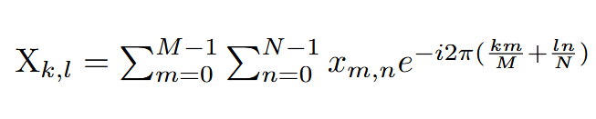
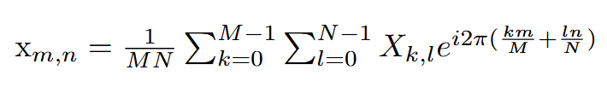
Mathematical Foundations of Transform Domain Watermarking Common Transform Types
Discrete Fourier Transform (DFT)
Advantages:
Complete frequency representation
Well-established mathematical properties
Suitable for global frequency analysis
Disadvantages:
Complex-valued coefficients
High computational complexity
No spatial localization

Slide 9
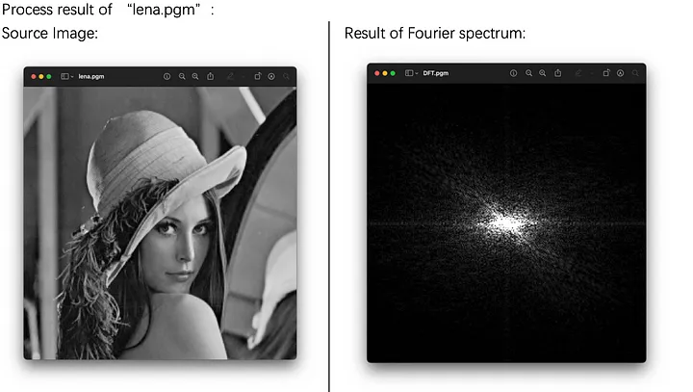
Mathematical Foundations of Transform Domain Watermarking Common Transform Types

Slide 10
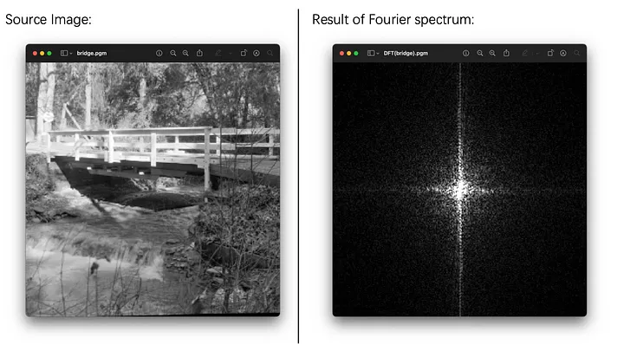
Mathematical Foundations of Transform Domain Watermarking Common Transform Types

Slide 11
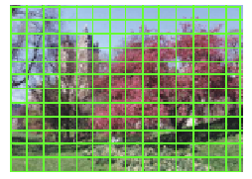
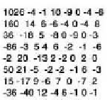
Mathematical Foundations of Transform Domain Watermarking Common Transform Types
Discrete Cosine Transform (DCT)
Advantages:
Real-valued coefficients Approximately Half of the DFT
Excellent energy compaction
Compatible with JPEG compression
Computationally efficient
Applications:
JPEG compression standard
Video compression (MPEG)
Most common choice for watermarking

Slide 12

Mathematical Foundations of Transform Domain Watermarking Common Transform Types
Lenna Image:
B(0,0)
B(0,1)
…
B(0,0)
BDCT
B(0,1)
……

Slide 13
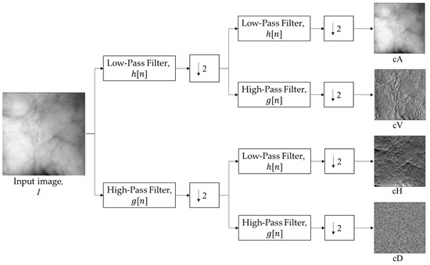
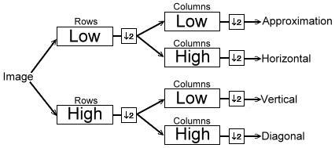
Mathematical Foundations of Transform Domain Watermarking Common Transform Types
Discrete Wavelet Transform (DWT)
The DWT provides multi-resolution analysis through:
Low-pass filtering: Approximation coefficients (LL)
High-pass filtering: Detail coefficients (LH, HL, HH)
Advantages:
Multi-resolution representation
Good time-frequency localization
Compatible with JPEG2000
Excellent for texture analysis

Slide 14
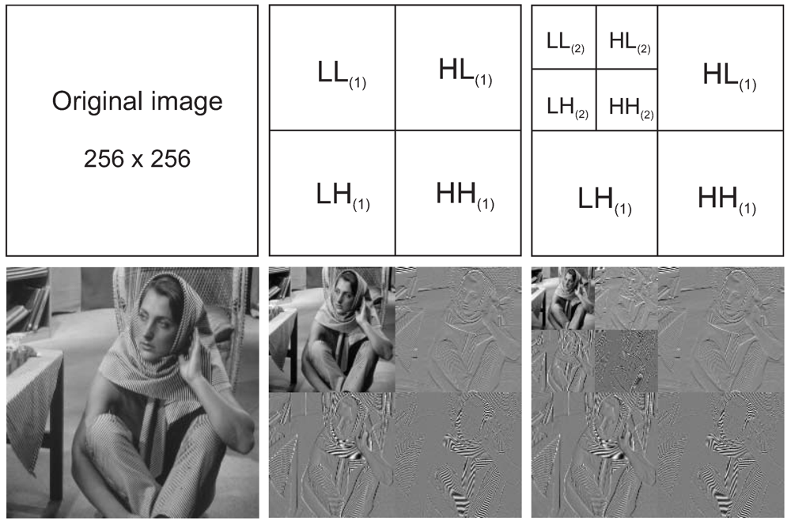
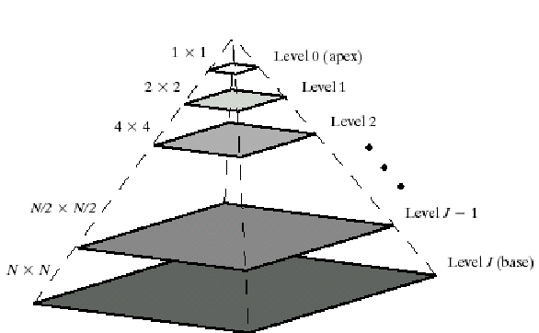
Mathematical Foundations of Transform Domain Watermarking Common Transform Types

Slide 15
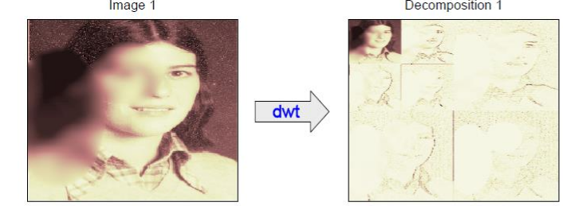
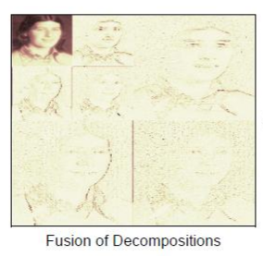
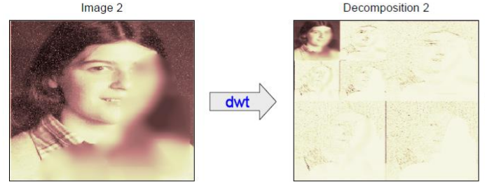
Mathematical Foundations of Transform Domain Watermarking Common Transform Types
Fusion

Slide 16
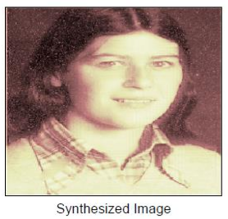
Mathematical Foundations of Transform Domain Watermarking Common Transform Types
IWDT

Slide 17
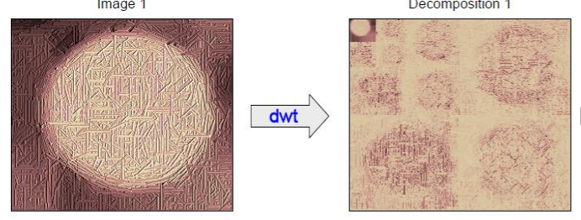
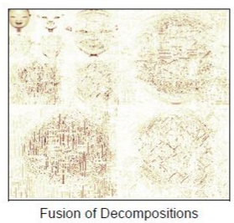
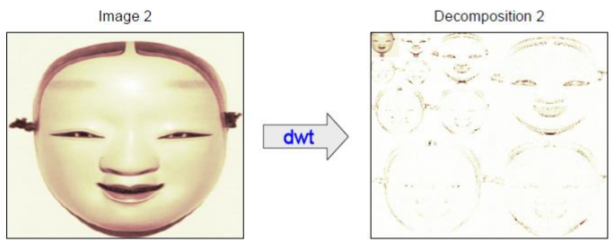
Mathematical Foundations of Transform Domain Watermarking Common Transform Types
Fusion

Slide 18

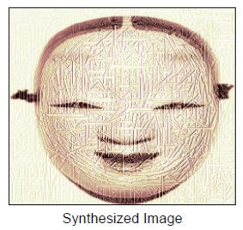
Mathematical Foundations of Transform Domain Watermarking Common Transform Types
IWDT

Slide 19
Watermarking Techniques in Transform Domain

Slide 20
Watermarking Techniques in Transform Domain LSB-Based Methods in Transform Domain
Modes:
1) Embed one bit at one DCT Coefficient.
2) Embed one bit at one DCT Coefficient after quantization.
3) Embed one bit per DCT Block.
Block-Based Procedure:
1. Divide image into 8×8 blocks
2. Apply transform (DCT/DFT/DWT) to each block
3. Modify LSBs of selected coefficients
4. Apply inverse transform
5. Reconstruct watermarked image
Host Image
Block-Based DCT
KEY
Watermark
Inverse
Block-Based DCT
Watermarked
Image
Encoding
Change LSB

Slide 21
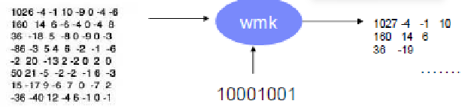
Watermarking Techniques in Transform Domain LSB-Based Methods in Transform Domain
Change LSB to Embed bit 1
010000000010
010000000011
Sign

Slide 22
Watermarking Techniques in Transform Domain LSB-Based Methods in Transform Domain
Change LSB to Embed bit 0
1100
1100
Sign

Slide 23
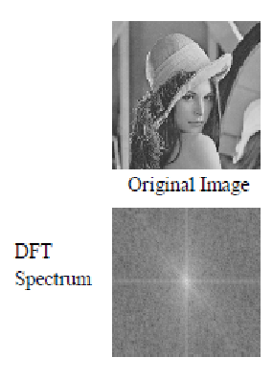
Watermarking Techniques in Transform Domain LSB-Based Methods in Transform Domain
Advantages:
Simple implementation
Low computational complexity
Maintains statistical properties locally
Disadvantages:
Limited robustness
Vulnerable to requantization
Block artifacts possible
It can also be done in global frequency domain.
1) Convert image to the global frequency domain
2) Select some band for embedding coefficients
3) Change the Least Significant Bit of the selected bands

Slide 24
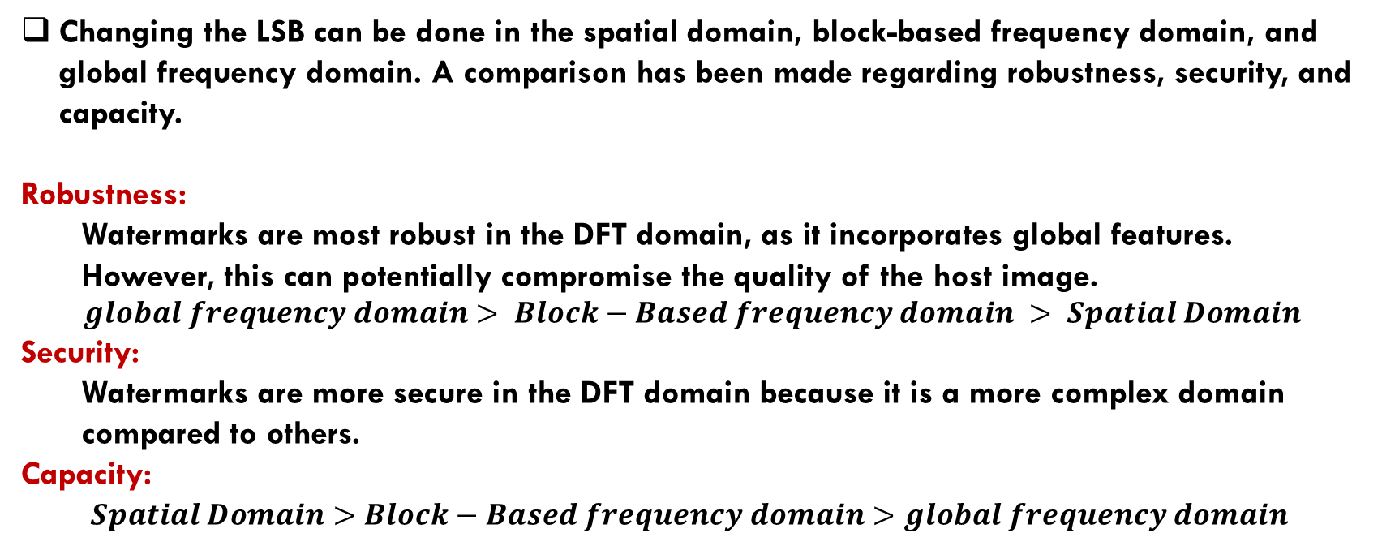
Watermarking Techniques in Transform Domain LSB-Based Methods – A comparison
Changing the LSB can be done in the spatial domain, block-based frequency domain, and global frequency domain. A comparison has been made regarding robustness, security, and capacity.
Robustness:
Watermarks are most robust in the DFT domain, as it incorporates global features. However, this can potentially compromise the quality of the host image.
$$global frequency domain> Block−Based frequency domain > Spatial Domain$$
Security:
Watermarks are more secure in the DFT domain because it is a more complex domain compared to others.
Capacity:
$Spatial Domain>Block−Based frequency domain>global frequency domain$

Slide 25
Watermarking Techniques in Transform Domain Substitution Methods in Transform Domain
Watermarked Transform Coefficients
Watermark
Watermark Strength
$$X^{′}\left(u,v\right)=X\left(u,v\right)+W\left(i,j\right) ×K$$
Original Transform Coefficients

Slide 26
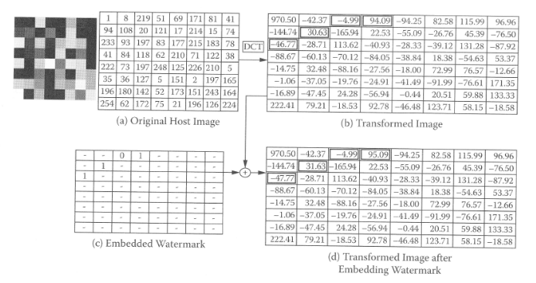
Watermarking Techniques in Transform Domain Substitution Methods in Transform Domain

Slide 27
Mathematical Foundations of Transform Domain Watermarking Common Transform Types
Lenna Image:
B(0,0)
B(0,1)
…
B(0,0)
BDCT
B(0,1)
……

Slide 28



Watermarking Techniques in Transform Domain Substitution Methods in Transform Domain
Example) Embed One bit into each DCT Block
$$W\left(i,j\right)=\left[\begin{matrix}1 & 1 \\ 0 & 1\end{matrix}\right]$$
Watermarked Block
B(0,0)
$$+$$
$$K ×$$
We can also select some of the Coefficients instead of summing them all.

Slide 29
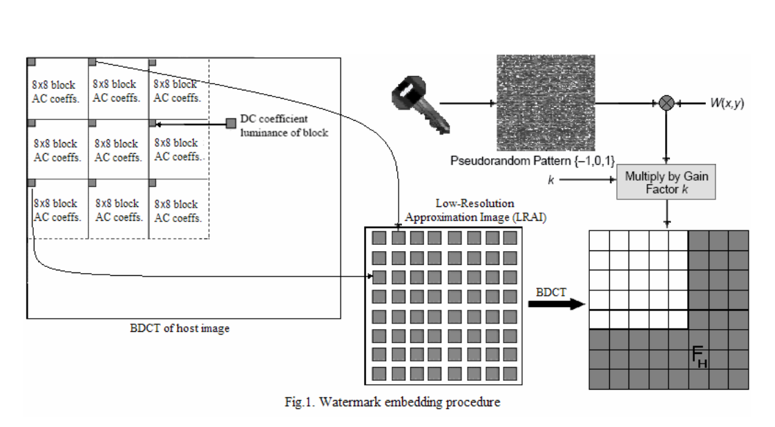
Watermarking Techniques in Transform Domain Substitution Methods in Transform Domain
Spread Spectrum could be considered as a Substitution Method which we embed each bit as random sequence(Spectrum).
2 Sequences:
Sequence for bit 1
Sequence for bit 0
39 Coefficients are selected

Slide 30
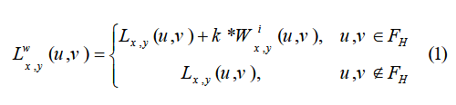
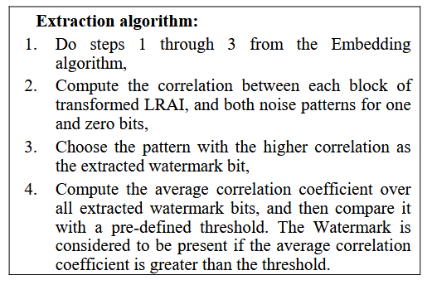
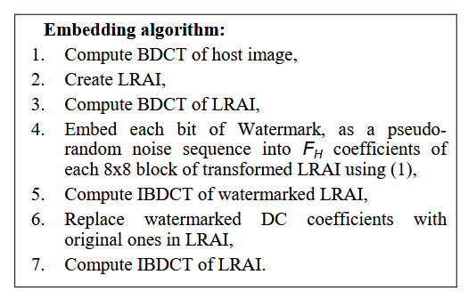
Watermarking Techniques in Transform Domain Substitution Methods in Transform Domain

Slide 31
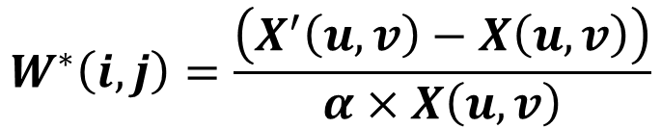
Watermarking Techniques in Transform Domain Multiplicative Watermarking
Embedding Formula:
Could be pseudorandom real numbers
$$X^{′}\left(u,v\right)=X\left(u,v\right)×\left(1+α×W\left(i,j\right)\right)$$
Watermark Strength
(usually 0.1)
Extraction Formula:
$$W^{∗}\left(i,j\right)=\frac{\left(X^{′}\left(u,v\right)−X\left(u,v\right)\right)}{α×X\left(u,v\right)}$$

Slide 32
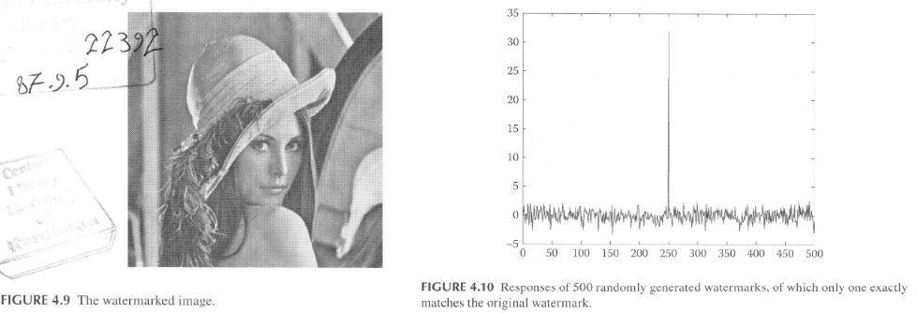
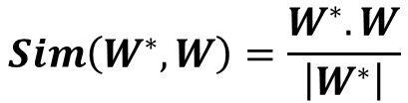
Watermarking Techniques in Transform Domain Multiplicative Watermarking
After Extraction of $W^{∗}\left(i,j\right),$ We calculate the Similarity of Extracted Watermark and the original Watermark. It should peek at some index.
$$Sim\left(W^{∗},W\right)=\frac{W^{∗}.W}{\left|W^{∗}\right|}$$

Slide 33
Watermarking Techniques in Transform Domain Multiplicative Watermarking
Advantages of Multiplicative Embedding
Adaptive strength:
Embedding strength proportional to coefficient magnitude
Perceptual optimization:
Stronger embedding in perceptually less important areas
Robustness:
Better resistance to scaling attacks

Slide 34
Watermarking Techniques in Transform Domain Rounding Error Problem
After embedding the watermark in the transform domain, rounding the floating-point coefficients to integer pixel values during the application of inverse transforms can introduce errors.
Impact:
Watermark distortion during extraction
Accumulation of quantization errors
Reduced extraction accuracy

Slide 35
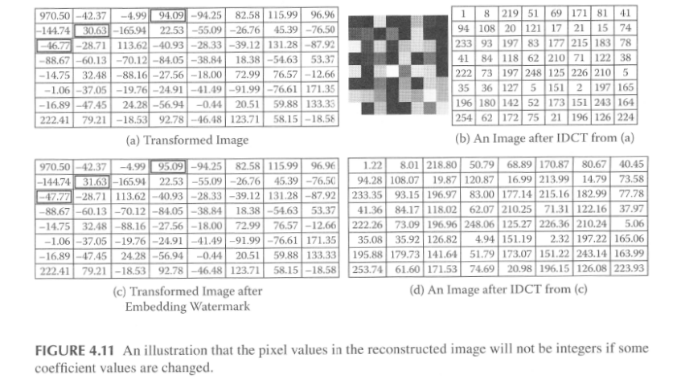
Watermarking Techniques in Transform Domain Rounding Error Problem

Slide 36
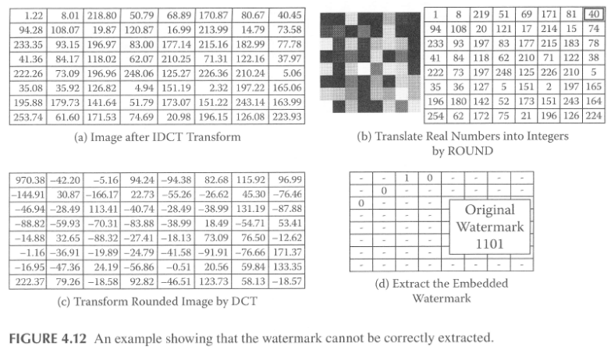
Watermarking Techniques in Transform Domain Rounding Error Problem

Slide 37
DCT-Based Watermarking: A Comprehensive Case Study

Slide 38

DCT-Based watermarking system overview - Embedding
Ref. Table Generator
R
$$\{X_{1}, X_{2}, …\}$$
X
Block Decomposition
Band Modification
Inverse DCT
DCT
$$\{y_{1}, y_{2}, …\}$$
$$\{y_{1}^{′}, y_{2}^{′}, …\}$$
$$\{X_{1}^{′}, X_{2}^{′}, …\}$$
Band Selection
S
S
Reconstruction
$$X^{′}$$
$$W_{p}$$
Pixel Permutation
Block Decomposition
W

Slide 39
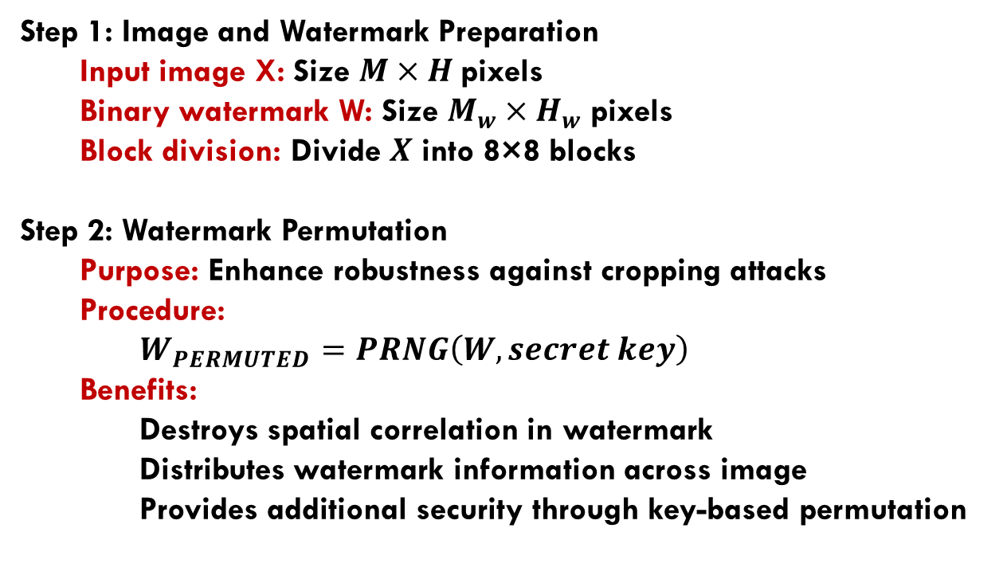
DCT-Based watermarking Detailed Embedding Procedure
Step 1: Image and Watermark Preparation
Input image X: Size $M×H$pixels
Binary watermark W: Size $M_{w}×H_{w}$pixels
Block division: Divide $X$ into 8×8 blocks
Step 2: Watermark Permutation
Purpose: Enhance robustness against cropping attacks
Procedure:
$W_{PERMUTED}=PRNG\left(W, secret key\right)$
Benefits:
Destroys spatial correlation in watermark
Distributes watermark information across image
Provides additional security through key-based permutation

Slide 40
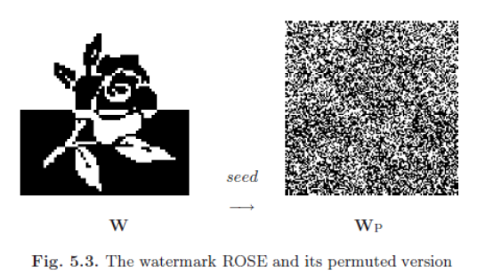
DCT-Based watermarking Detailed Embedding Procedure

Slide 41
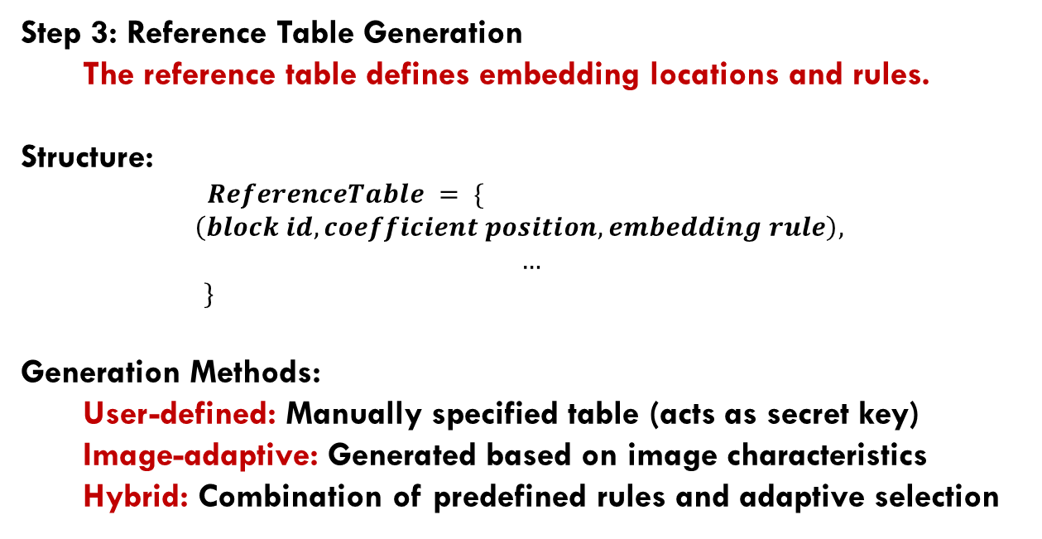
DCT-Based watermarking Detailed Embedding Procedure
Step 3: Reference Table Generation
The reference table defines embedding locations and rules.
Structure:
$ReferenceTable = \{$
$$\left(block id, coefficient position, embedding rule\right),$$
$$…$$
$\}$
Generation Methods:
User-defined: Manually specified table (acts as secret key)
Image-adaptive: Generated based on image characteristics
Hybrid: Combination of predefined rules and adaptive selection

Slide 42
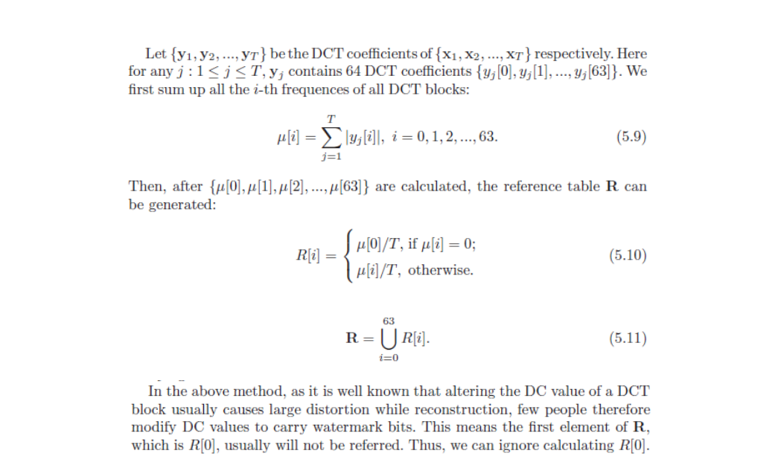
DCT-Based watermarking Detailed Embedding Procedure
Reference Table – Case Study

Slide 43
DCT-Based watermarking Detailed Embedding Procedure
Step 4: DCT Coefficient Modification
For each selected coefficient:
$$DCT_coeff_modified = modify_coefficient(DCT_coeff_original, watermark_bit, embedding_rule)$$
Modification Strategies:
Quantization-based: Round coefficient to nearest quantization level
Parity-based: Set coefficient parity to match watermark bit
Threshold-based: Ensure coefficient magnitude exceeds threshold
Spread-Spectrum: Embed A pseudo-random sequence and calculate correlations

Slide 44
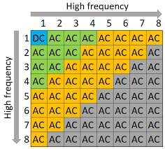
DCT-Based watermarking Band Selection Strategy
Low Frequencies (DC and nearby AC coefficients):
- Contain most image energy
- Highly perceptible when modified
- Very robust to attacks
- Risk of visible artifacts
Mid Frequencies:
- Moderate energy content
- Balance between perceptibility and robustness
- Optimal for most watermarking applications
- Good compromise solution

Slide 45
DCT-Based watermarking Band Selection Strategy
High Frequencies:
- Low energy content
- Less perceptible when modified
- Vulnerable to compression and filtering
- Suitable for fragile watermarking

Slide 46
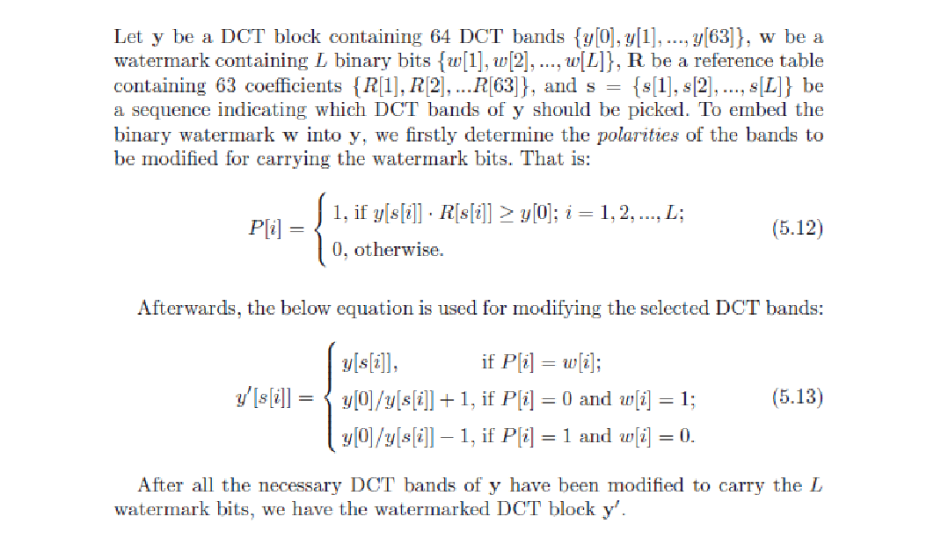
Band Modification – Case Study

Slide 47


DCT-Based watermarking system overview - extraction
Ref. Table Generator
$$R^{′}$$
$$\{{\hat{X}}_{1},{\hat{X}}_{2}, …\}$$
X
Block Decomposition
Watermark Extraction
Reconstruction
DCT
$$\{{\hat{y}}_{1},{\hat{y}}_{2},, …\}$$
$$\{\hat{W_{1}}, \hat{W_{2}}…\}$$
$$\hat{W_{P}}$$
Band Selection
S
S
Reconstruction
$$\hat{W}$$

Slide 48
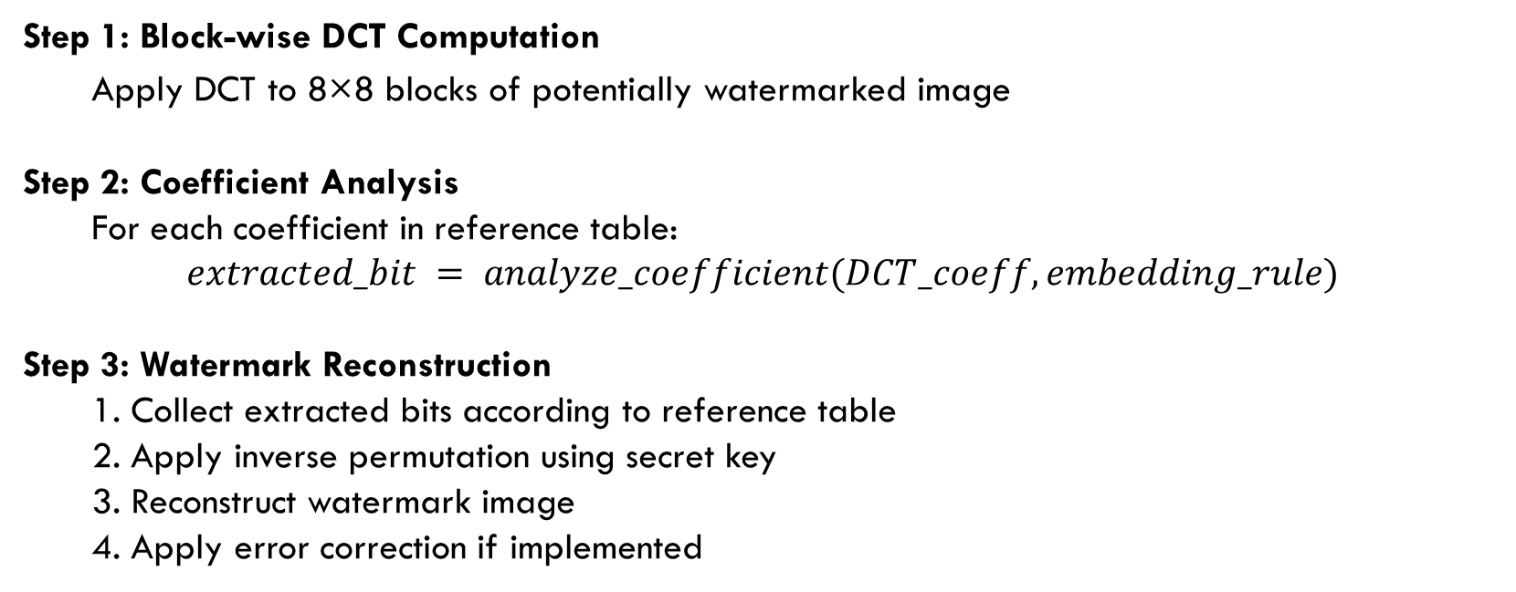
DCT-Based watermarking Extraction Procedure
Step 1: Block-wise DCT Computation
Apply DCT to 8×8 blocks of potentially watermarked image
Step 2: Coefficient Analysis
For each coefficient in reference table:
$$extracted_bit = analyze_coefficient(DCT_coeff, embedding_rule)$$
Step 3: Watermark Reconstruction
1. Collect extracted bits according to reference table
2. Apply inverse permutation using secret key
3. Reconstruct watermark image
4. Apply error correction if implemented

Slide 49
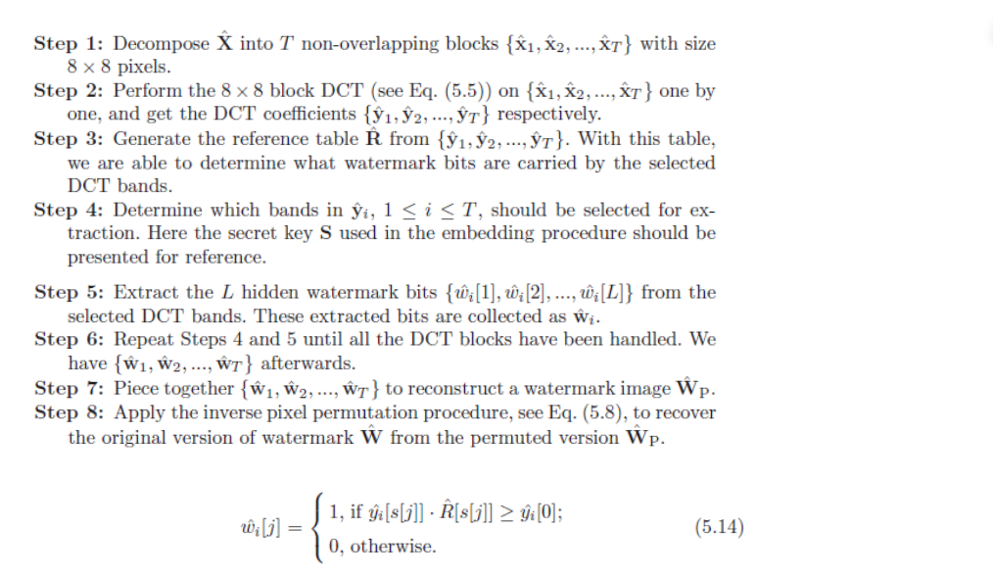
Extraction Steps – Case Study

Slide 50
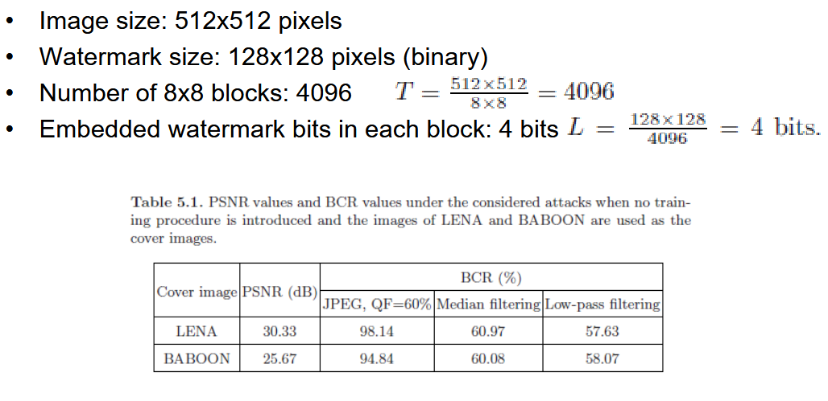
DCT-Based watermarking Simulation results of our case study

Slide 51
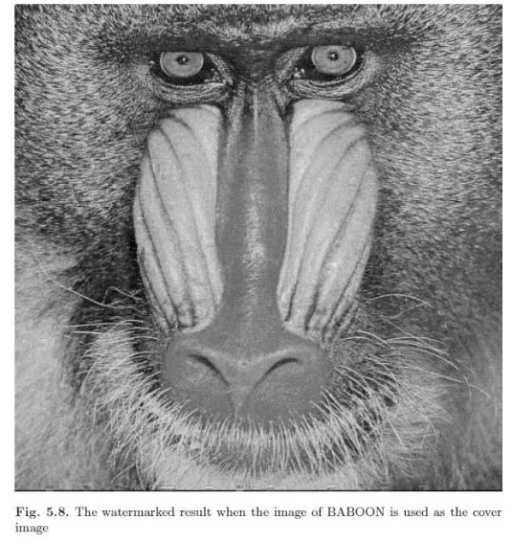
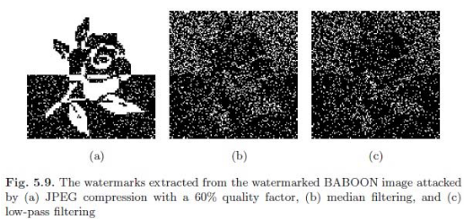
DCT-Based watermarking Simulation results of our case study

Slide 52
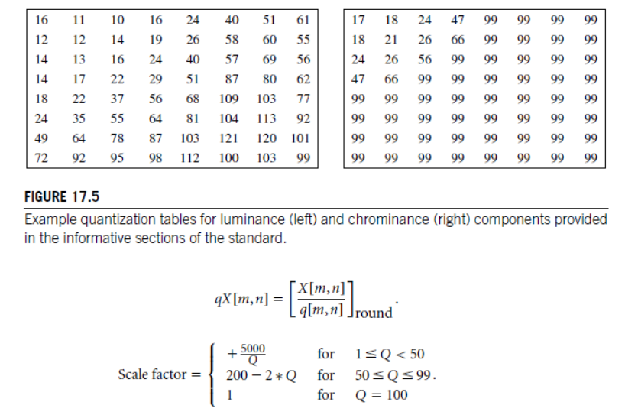
DCT-Based watermarking jpeg quantization table and quality factor

Slide 53
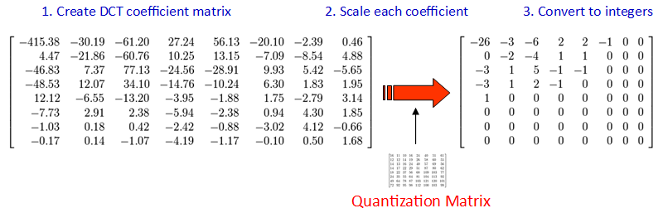
DCT-Based watermarking jpeg quantization table and quality factor

Slide 54
Advanced Optimization: Genetic Band Selection (GBS)

Slide 55
Advanced Optimization: Genetic Band Selection Motivation for Optimization
Traditional frequency band selection relies on heuristic rules and general principles. However, optimal band selection depends on:
Specific image characteristics
Target attack scenarios
Quality-robustness trade-offs
Application requirements
Genetic Band Selection (GBS) provides an automated approach to optimize band selection for specific conditions.

Slide 56
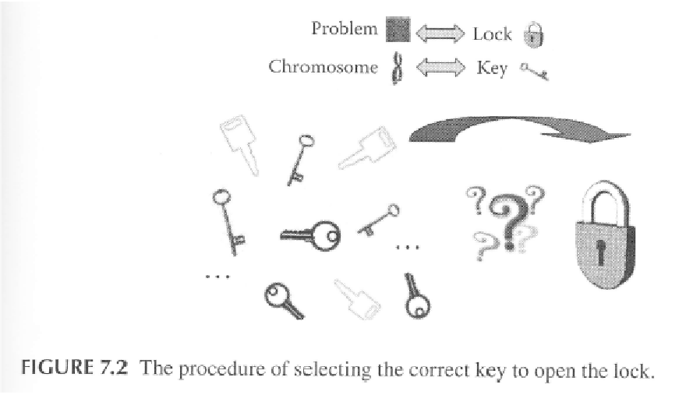
Advanced Optimization: Genetic Band Selection Genetic Algorithm Fundamentals

Slide 57
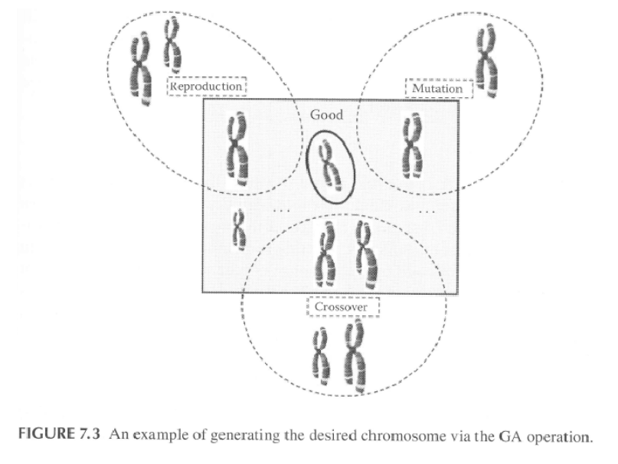
Advanced Optimization: Genetic Band Selection Genetic Algorithm Fundamentals

Slide 58
Advanced Optimization: Genetic Band Selection Genetic Algorithm Fundamentals
Population: Set of candidate solutions (band selection configurations)
Each individual (called chromosome) in the population correspond to a solution in the problem domain.
An objective, called fitness function is used to evaluate the quality of each chromosome
$$Population = \{Chromosome_1, Chromosome_2, ..., Chromosome_N\}$$

Slide 59

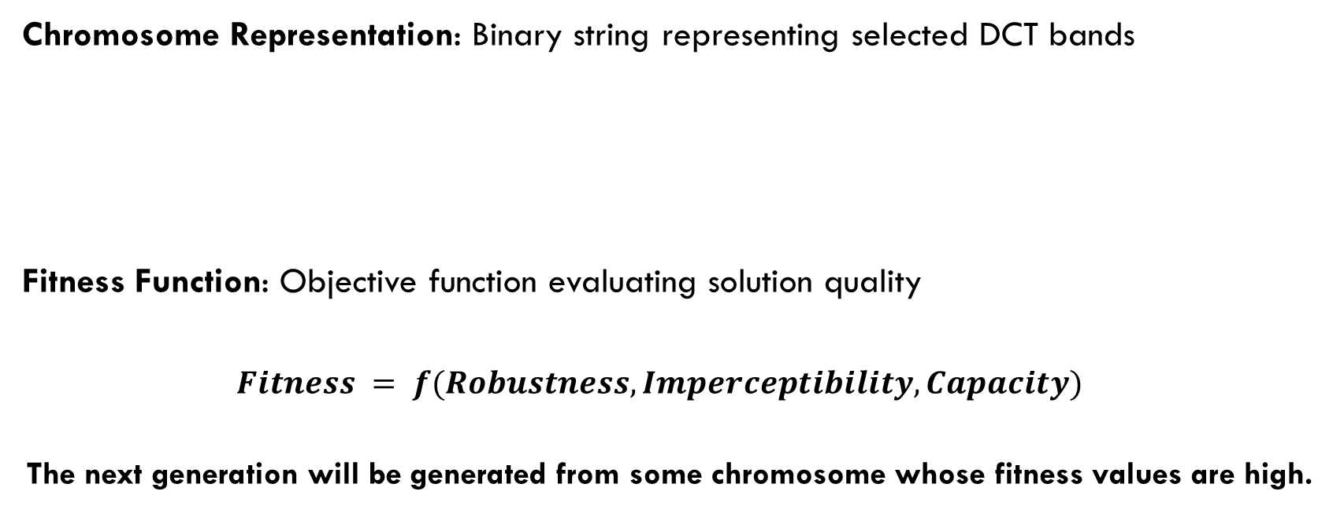
Advanced Optimization: Genetic Band Selection Genetic Algorithm Fundamentals
Chromosome Representation: Binary string representing selected DCT bands
Fitness Function: Objective function evaluating solution quality
$$Fitness = f(Robustness, Imperceptibility, Capacity)$$
The next generation will be generated from some chromosome whose fitness values are high.
$$Chromosome = \left[b1, b2, b3, ..., b64\right]$$
$$where bi = 1 if coefficient i is selected, 0 otherwise$$

Slide 60
Advanced Optimization: Genetic Band Selection Genetic Algorithm Fundamentals
Reproduction (Selection) , crossover and mutation are the three basic operators used to reproduce chromosome in order to obtain the best solution.
Selection: Choose parents for reproduction based on fitness
- Roulette Wheel: Probability proportional to fitness
- Tournament: Select best from random subset
- Elitism: Always retain best solutions

Slide 61
Advanced Optimization: Genetic Band Selection Genetic Algorithm Fundamentals
Crossover: Combine parent chromosomes to create offspring
- Single-point: Split at random position
- Multi-point: Multiple splitting points
- Uniform: Random selection from each parent
Mutation: Random modification to maintain diversity
- Bit-flip: Randomly invert selected bits
- Adaptive: Mutation rate depends on population diversity

Slide 62
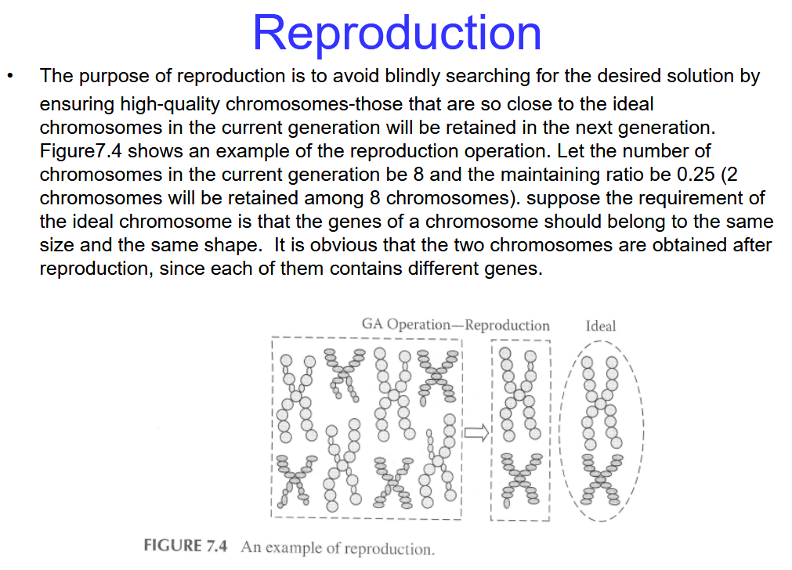

Slide 63
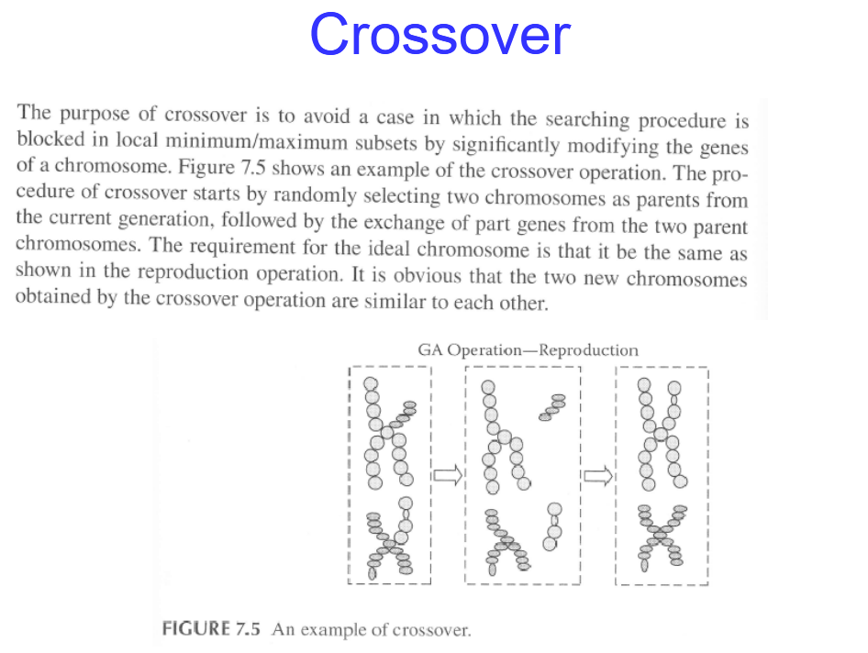

Slide 64
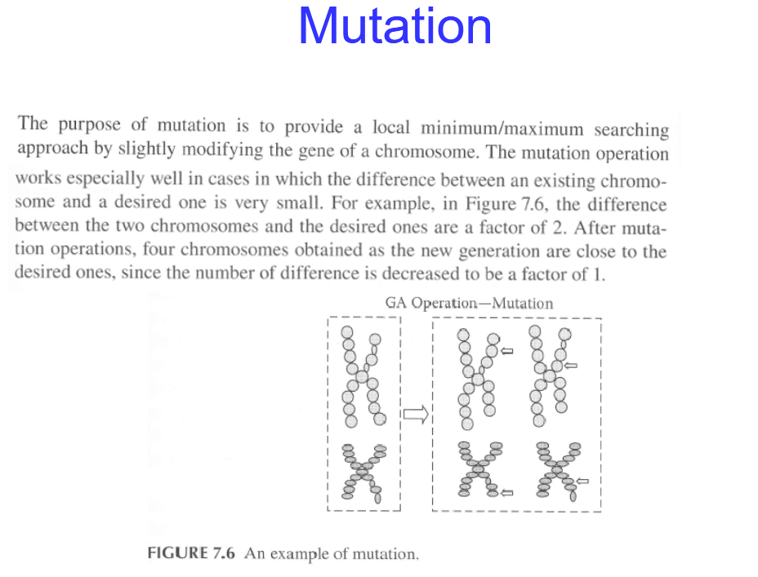

Slide 65

Advanced Optimization: Genetic Band Selection Genetic Algorithm Fundamentals
The process will be repeated until a predefined condition is satisfied or the desired number of iterations is reached
Multi-Objective Fitness Function:
$Fitness = w1 × Robustness + w2 × Imperceptibility + w3 × Capacity − w4 × Complexity$
- Robustness: Measured by correlation after attacks
- Imperceptibility: Measured by PSNR or SSIM
- Capacity: Number of embedded bits
- Complexity: Computational cost
- w1, w2, w3, w4: Weighting factors

Slide 66

Advanced Optimization: Genetic Band Selection Training Procedure
Phase 1: Initialization
1) Generate random initial population
2) Define fitness function parameters
3) Set GA parameters (population size, generations, etc.)
Phase 2: Evolution Loop
$for generation = 1 to max_generation:$
$$evaluate_fitness(population)$$
$$select_parents(population)$$
$$generate_offspring(crossover, mutation)$$
$$evaluate_offspring_fitness()$$
$$select_survivors(elitism_stategy)$$
$$update_poppulation()$$
$$check_termination_criteria()$$

Slide 67
Advanced Optimization: Genetic Band Selection Training Procedure
Phase 3: Result Analysis
Extract best chromosome (optimal band selection)
Validate performance on test set
Store optimized configuration as secret key

Slide 68


Slide 69


Slide 70

DCT-Based watermarking with Genetic Band Selection Simulation results of our case study

Slide 71

DCT-Based watermarking with Genetic Band Selection Simulation results of our case study

Slide 72

DCT-Based watermarking with Genetic Band Selection Simulation results of our case study

Slide 73


DCT-Based watermarking with Genetic Band Selection Simulation results of our case study

Slide 74


DCT-Based watermarking with Genetic Band Selection Simulation results of our case study

Slide 75

DCT-Based watermarking with Genetic Band Selection Considering more attacks

Slide 76

DCT-Based watermarking with Genetic Band Selection Considering more attacks

